Slide 1
ET0023 Operating Systems
11. File Systems

Slide 2
The Big Picture
Users
Storing Information
Applications can store it in the process address space
Why is it a bad idea?
Size is limited to size of virtual address space
The data is lost when the application terminates
Multiple processes might want to access the same data
Processes
Storage
Retrieval
Files
Directories
Directories
FileSystem
Storage

Slide 3
File Systems
3 criteria for long-term information storage:
Should be able to store very large amount of information
Information must survive the processes using it
Should provide concurrent access to multiple processes
Solution:
Store information on disks in units called files
Files are persistent, and only owner can explicitly delete it
Files are managed by the OS
File Systems: How the OS manages files!

Slide 4
What does a FILE have?
Name
Data
FILE
… (other)
Attributes
File size Owner Creation Date Rights

Slide 5
Properties of a File
File Operations – what you can do with a file
File Naming – uniquely identify the file
File Structure – how OS sees the data inside
File Access – sequential access, random access
File Attributes – information about the file
File Types – different types of use

Slide 6
File Operations
Create
The file is created with no data.
Delete
File no longer needed, is deleted to free up disk space.
Open
Before using a file, a process must open it.
Close
When a process no longer needs to use a file, the file is closed
Read
Data is read from the file.
Write
Data is written to the file.
Append
Data is added to the end of the file.
Seek
Positions the file pointer to a specific place in the file.
Get attributes
Read the file attributes.
Set attributes
Change the attributes of the file.
Rename
Change the name of the file.

Slide 7
File Attributes
File-specific info maintained by the OS
File size, modification date, creation time, etc.
Varies a lot across different OSes
Some examples:
Name – only information kept in human-readable form
Identifier – unique tag (number) identifies file within file system
Type – needed for systems that support different types
Location – pointer to file location on device
Size – current file size
Protection – controls who can do reading, writing, executing
Time, date, and user identification – data for protection, security, and usage monitoring

Slide 8
File Naming
Motivation: Files abstract information stored on disk
You do not need to remember block, sector, …
We have human readable names
How does it work?
Process creates a file, and gives it a name
Other processes can access the file by that name
Naming conventions are OS dependent
Usually names as long as 255 characters is allowed
Digits and special characters are sometimes allowed
MS-DOS and Windows are not case sensitive, UNIX/Linux family is case sensitive.

Slide 9
File Extensions
Name divided into 2 parts, second part is the extension
On UNIX, extensions are not enforced by OS
However C compiler might insist on its extensions
These extensions are very useful for C
Windows attaches meaning to extensions
Tries to associate applications to file extensions

Slide 10
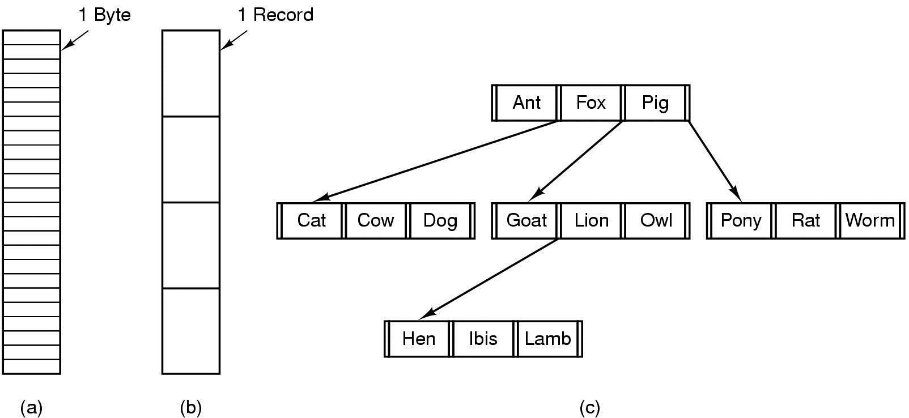
File Structure
Byte sequence Record sequence Tree of records

Slide 11
File Access
Sequential access
Read all bytes/records from the beginning
Cannot jump around, could rewind or forward
Convenient when medium was magnetic tape
Random access
bytes/records read in any order
Essential for database systems
Suitable when secondary storage used are also random access e.g. Hard Disks

Slide 12
File Attributes
File-specific info maintained by the OS
File size, modification date, creation time, etc.
Varies a lot across different OS's
Some examples:
Name – only information kept in human-readable form
Identifier – unique tag (number) identifies file within file system
Type – needed for systems that support different types
Location – pointer to file location on device
Size – current file size
Protection – controls who can do reading, writing, executing
Time, date, and user identification – data for protection, security, and usage monitoring

Slide 13
File Protection
File owner/creator should be able to control:
what can be done
by whom
Types of access
Read
Write
Execute
Append
Delete
List

Slide 14
Categories of Users
Individual user
Log in establishes a user-id
Might be just local on the computer or could be through interaction with a network service
Groups to which the user belongs
Again could just be automatic or could involve talking to a service that might assign, say, a temporary cryptographic key

Slide 15
Linux Access Rights
Mode of access: read, write, execute (RWX)
Three classes of users
owner access 7 1 1 1 RWX
group access 6 1 1 0 RW-
public access 1 1 0 0 R - -
For a particular file (say game) or subdirectory, define an appropriate access.
owner group public
chmod 761 game

Slide 16
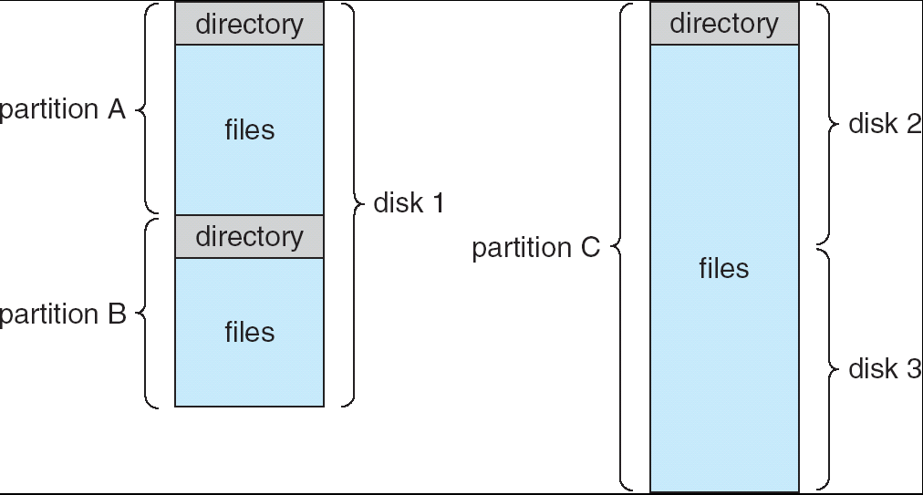
File System on Disk
Could use entire disk space for a FS, but
A system could have multiple File Systems
Want to use some disk space for swap space
Disk divided into partitions, slices or minidisks
Chunk of storage that holds a FS is a volume
Directory structure maintains info of all files in the volume
Name, location, size, type, …

Slide 17
Directories
Directories/folders keep track of files
Is a symbol table that translates file names to directory entries
Usually are themselves files
How to structure the directory to optimize the following:
Search a file, Create a file, Delete a file, List directory, Rename a file, Traversing the FS
3 types of directory systems
Single-level directory
Two-level directory
Hierarchical directory

Slide 18
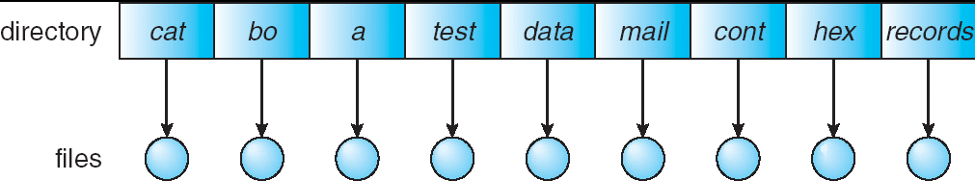
Single Level Directory
One directory for all files in the volume (root)
Used in early PCs (even in first supercomputers)
Pros: Simplicity, Able to quickly locate files
Cons: Inconvenient naming (uniqueness)

Slide 19
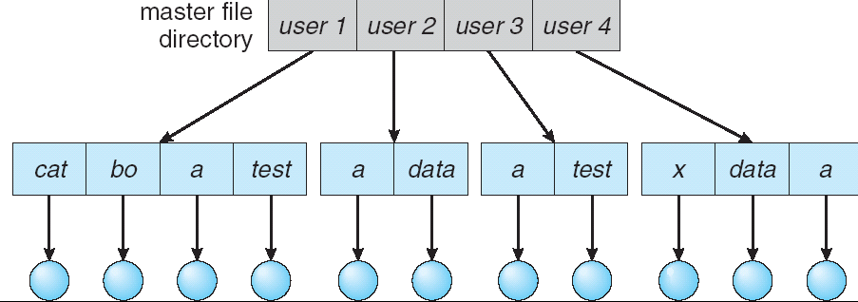
Two-level Directories
Each user has a separate directory
Solves name collision, but bad if a user(s) has many files
May not allow file sharing or access
User file
directory

Slide 20
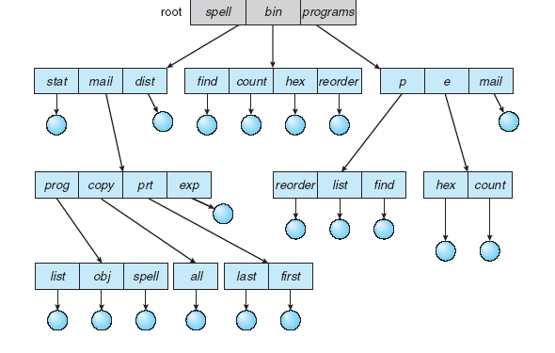
Hierarchical Directories
Directory created as a tree of arbitrary height.
Contains files and sub-directories
A bit in directory entry differentiates files from sub-directories
Pros: Very flexible, allows users to group files
Cons: Most complicated of all

Slide 21
Path Names
To access a file, the user should either:
Go to the directory where file resides, or
Specify the path where the file is
Path names are either absolute or relative
Absolute: path of file from the root directory
Relative: path from the current working directory
Most OSes have two special entries in each directory:
“.” for current directory, and
“..” for parent

Slide 22
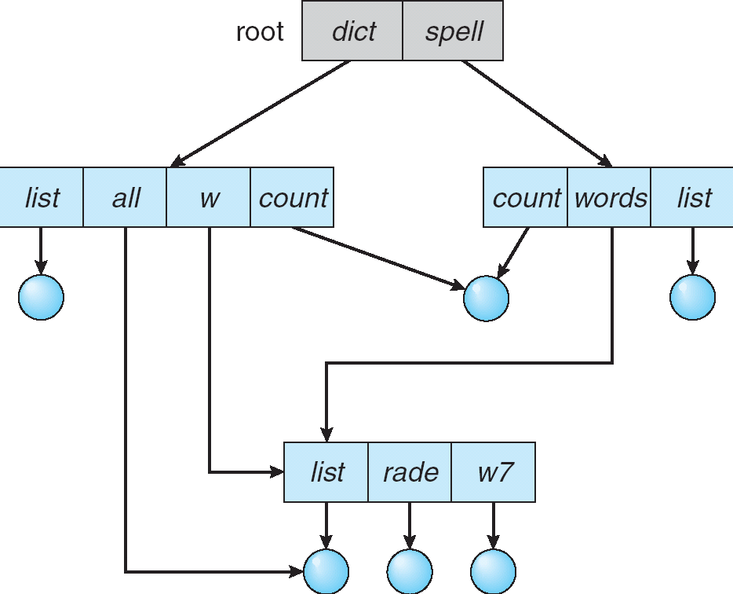
Path Names (Acyclic Graph Directories)
/dict/all/file1 /spell/words/w7/file3

Slide 23
Acyclic Graph Directories
How to implement shared files and subdirectories:
Why not copy the file?
New directory entry, called Link (used in UNIX/Linux)
Link is a pointer to another file or subdirectory
Links are ignored when traversing FS
ln in UNIX, fsutil in Windows for hard links
ln -s in UNIX, shortcuts in Windows for soft links
Issues?
Two different names (aliasing)
If dict deletes count dangling pointer
Keep back-pointers of links for each file
Leave the link, and delete only when accessed later
Keep reference count of each file

Slide 24
Re-cap
Files are stored on file systems.
File systems are stored on hard disks.
Most Hard disks can be divided (partitioned) with independent file systems on each partition.
Examples of file systems:
FAT, FAT32, NTFS, ext2, ext3, ext4, HFS
Notes:
Hierarchical File System (HFS) is a proprietary file system developed by Apple Inc. for use in computer systems running Mac OS.

Slide 25
Basic Input Output System
A BIOS that is responsible for starting the computer and booting into the operating system.
The BIOS performs a series of Power On Self Test (POST) before loading a bootloader from a master boot record on a storage device and executes it.
The bootloader then loads the operating system from the storage device.
The BIOS was originally devised as an interface between hardware devices and the DOS.
The BIOS role is to begin the boot process, and is largely irrelevant once the OS has booted.
Notes:
Every PC has a BIOS that is responsible for starting the computer and booting into the operating system.
The BIOS performs a series of Power On Self Test (POST) before loading a bootloader from a master boot record on a storage device and executes it.
The bootloader then loads the operating system from the storage device.
The BIOS was originally devised as an interface between hardware devices and the DOS. It was, and remains, a 16-bit real-mode programme.
The OS no longer use the BIOS interface, but contain their own device drivers instead.
The BIOS role has been reduced to beginning the boot process, and is largely irrelevant once the OS has booted.

Slide 26
Master Boot Record (MBR)
Sector 0 of the disk is called the MBR (Master Boot Record) and is used to boot the computer.
The end of the MBR contains the partition table.
This table gives the starting and ending addresses of each partition.
One of the partitions in the table is marked as active.
When the computer is booted, the BIOS reads in and executes the MBR.
The first thing the MBR program does is locate the active partition, read in its first block, called the boot block, and execute it.
The program in the boot block loads the operating system contained in that partition.
Notes:
The MBR serves tow purposes: it contains the partition table that defines the location of the filesystems on the disk. All of this information is stored in the first sector (called the sector 0) of the disk.
sector 0 is limited to 512 bytes: 446 bytes for the bootloader, and a partition table containing up to four 16-byte records. The last two bytes contain a signature that the BIOS uses to recognise a valid MBR.
The partition tables use 32-bit sector addresses fields, which means they can’t address disks larger that 2TiB.
This type of partition table is often referred to as an MSDOS partition table in an attempt to differentiate it fro the new GPT.
The new GPT partitioning scheme overcomes this limitation by using 64-bit fields, and these allow storage of 2^64 512-byte sectors, or 8ZiB (9.4ZB).

Slide 27
master boot record
Structure of a classical generic MBR
Address |  | Description |  | Size inbytes
Hex | Dec
+000h | +0 | Bootstrap code area |  | 446
+1BEh | +446 | Partition entry#1 | Partition table (for primary partitions) | 16
+1CEh | +462 | Partition entry#2 |  | 16
+1DEh | +478 | Partition entry#3 |  | 16
+1EEh | +494 | Partition entry#4 |  | 16
+1FEh | +510 | 55h | Boot signature^{[a]} | 2
+1FFh | +511 | AAh
Total size: 446 + 4*16 + 2 |  |  |  | 512
http://en.wikipedia.org/wiki/MBR_partition_table#PT
Notes:
A master boot record (MBR) is a special type of boot sector at the very beginning of partitioned computer mass storage devices like fixed disks or removable drives intended for use with IBM PC-compatible systems and beyond. The concept of MBRs was publicly introduced in 1983 with PC DOS 2.0.
The MBR holds the information on how the logical partitions, containing file systems, are organized on that medium. Besides that, the MBR also contains executable code to function as a loader for the installed operating system—usually by passing control over to the loader's second stage, or in conjunction with each partition's volume boot record (VBR). This MBR code is usually referred to as a boot loader.
The organization of the partition table in the MBR limits the maximum addressable storage space of a disk to 2 TB (2³² × 512 bytes).^{[1]} Therefore, the MBR-based partitioning scheme is in the process of being superseded by the GUID Partition Table (GPT) scheme in new computers. A GPT can coexist with an MBR in order to provide some limited form of a backwards compatibility for older systems.
MBRs are not present on non-partitioned media like floppies, superfloppies or other storage devices configured to behave as such.

Slide 28
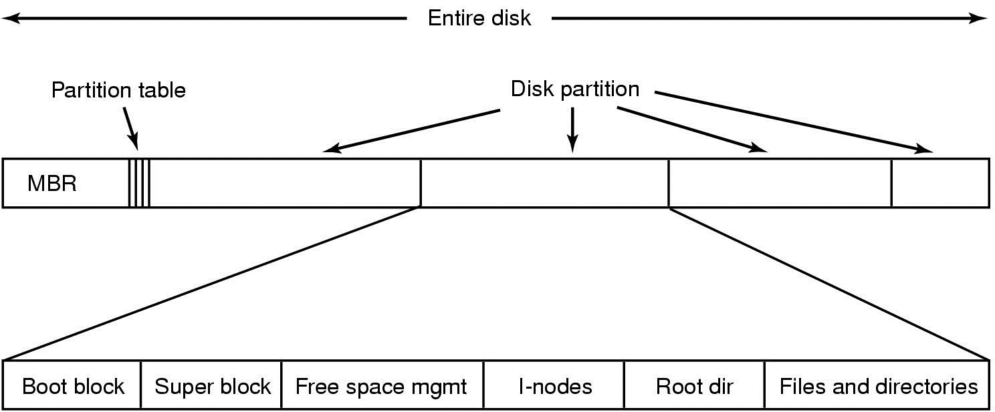
File System Layout
You can have as many extended partitions as you like, but you can only have a maximum of 4 primary partitions for each hard disk.

Slide 29
MSDOS Partition Table
Limitation:
Limited to one bootloader
Limited to four partitions
Limited to 2 TiB maximum disk size.
UEFI supports multiple bootloaders.
UEFI able to secure the boot process.
GPT supports up to 128 partitions
Works with disks up to 8ZiB (9.4ZB).
Notes:
BIOS is superseded by Unified Extensible Firmware Interface, and the MBR by the GUID Partition Table.
The BIOS expects the bootloader to be located in the first sector of the disk, there can only be one bootloader per disk.
Most BIOSes allow selection of the boot disk and therefore, can support as many bootloaders as there are physical disks.
In contrast, UEFI ignores any bootloader in sector 0, but instead allows multiple bootloaders to exist on a single disk by using a special partition instead of an absolute sector. The special partition is known as the EFI System Partition or ESP. ESP is formatted with a FAT fileSystem (usually FAT32) and typically sized between 100MiB or 250 MiB.
The UEFI specification requires it to be the first partition and that it must have its boot flag set.
On a Linux system, it is customary to mount the ESP under /boot/efi. Convention dictates that bootloaders are stored on the ESP in vendor specific sub-directories. The UEFI forum maintains a list of these sub-directories at www.uefi.org/specs/esp_registry.

Slide 30
GUID Partition Table Scheme
LBA 0
Protective MBR
Primary GPT Header
Entry 1 | Entry 2 |Entry 3 |Entry 4
Entry 5 -128
Partition 1
Partition 2
Remaining Partitions
Entry 1 | Entry 2 |Entry 3 |Entry 4
Entry 5 -128
Secondary GPT Header
LBA 1
LBA 2
LBA 3
LBA 34
LBA -34
LBA -33
LBA -2
LBA -1
Notes:
A GPT contains two copies of its partition table, plus a protective MS-DOS partition table.
The UEFI firmware can read partition tables and FAT filesystems.
Globally Unique Identifier (GUID) is an implementation of UUID.
The GPT uses GUIDs to identify disks and partitions. It begins at sector 1 with a header that defines the number and size of the partition records in the table that follows. The header contains two GUIDs: the first represents the partition’s type and the second uniquely identifies it. The header also contains a CRC32 checksum that can be used by the firmware or OS to verify data integrity.
The GPT can hold 128 partitions, and this removes the need for logical and extended partitions. Each partition record is 128 bytes long and contains the GUIDs, the partition’s beginning and end sector addresses, some attributes and a human-readable name. A second copy of the GPT is stored at the end of the disk as backup. To accommodate 128 such partition records requires 16384 bytes. This is 32 sectors, which means that the first usable sector on a GPT disk is sector 34.
The GPT scheme also includes a master boot record, an its purpose is to help prevent corruption of a GPT disk by tools that are not GPT aware. This Protective MBR, or PMBR, contains an MSDOS partition table with one partition covering the whole disk (or 2 TiB if the disk is bigger). This partition is mark with type of 0xEE. Systems unaware of GPT will see an unknown partition occupying the whole disk and leaving no available space.
Another use of the protective MBR is to allow a BIOS to boot a GPT disk. If it contains a bootloader then the BIOS will blindly load and execute it. If that bootloader understand GPT then it can boot it. One such bootloader is Grub2, and is used by many Linux distributions. This allows BIOS-based systems to use disks greater than 2TiB.
MS-DOS partitioned disks usually leave a gap (known as the DOS Compatibility region),starting at sector and running up to the beginning of the first partition. Bootloaders traditionally used this unallocated space to locate code (Grub 1 wrote its stage 1.5 loader here). With GPT, the partition table begins at sector 1, immediately after the PMBR – so there is no unallocated space to use in this way. Instead, the GPT specification provides for a special BIOS boot partition for use by boot loaders that would otherwise have used the DOS Compatibility region. Grub 2 writes its bootloader directly onto that partition (it does not contain a filesystem). Given that the presence of the DOS Compatibility region was by convention rather than definition, having a specifically allocated partition is more robust.

Slide 31
Partition Contents
What do we find inside every partition:
Boot Block
Superblock.
Information about free blocks.
I-nodes.
Root directory.
Remainder of disk space.
Notes:
# dumpe2fs /dev/sda1 printout important block info about the partition.

Slide 32
Partition Contents
Boot block
Instructions to load the operating system are stored inside here.
Superblock
Contains key parameters about the file system, such as:
A magic number to identify the file system type.
The total number of blocks in the file system.
Other key administrative information
Cmd: root > dumpe2fs /dev/sda1

Slide 33
Partition Contents
I-nodes
Is an array of data structures, one per file, telling all about the file.
Root directory
Contains the top of the file system tree.
Remainder of disk space
Contains all the other disk directories and files.

Slide 34
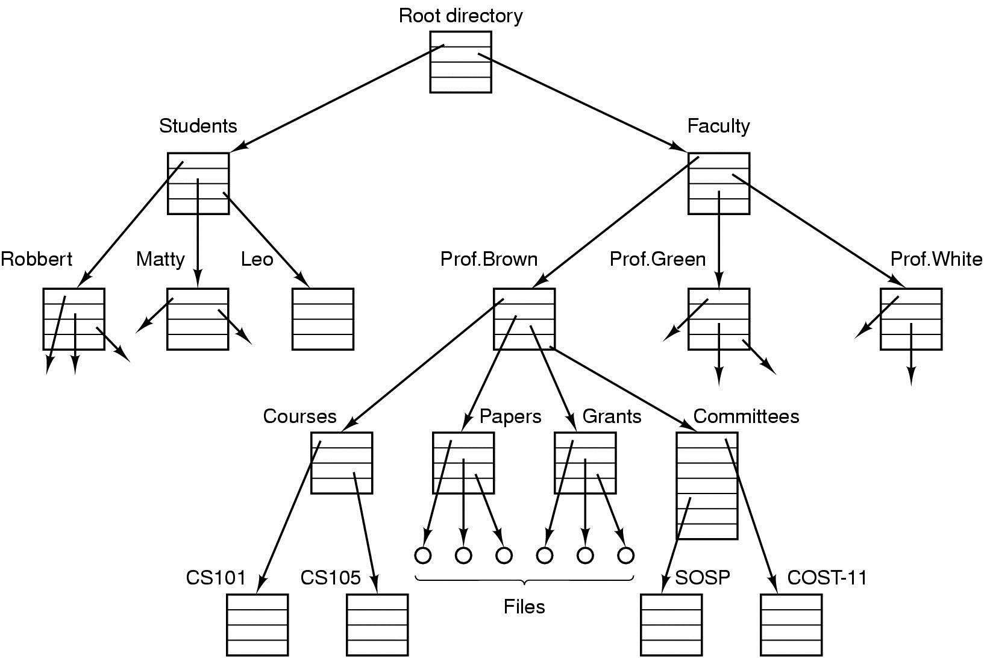
File System Hierarchy

Slide 35
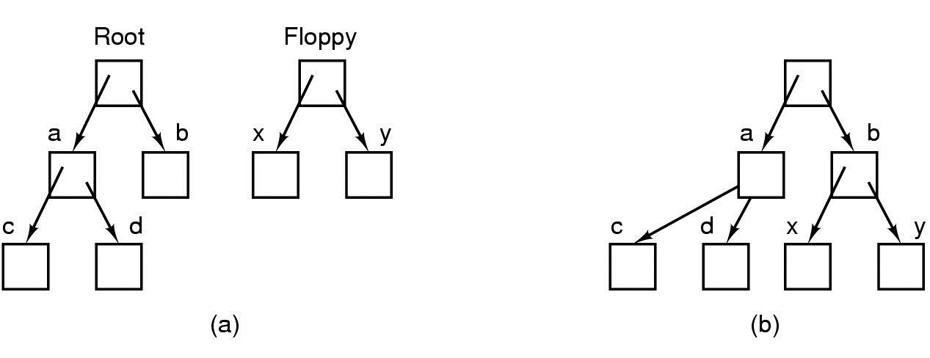
Mounted File Systems
Before mounting, files on floppy are inaccessible.
After mounting floppy on b, files on floppy are part of file hierarchy.

Slide 36
Storing Files
Files can be allocated in different ways:
Contiguous allocation
All bytes together, in order
Linked Structure
Each block points to the next block
Indexed Structure
An index block contains pointer to many other blocks
Rhetorical Questions -- which is best?
For sequential access? Random access?
Large files? Small files? Mixed?

Slide 37
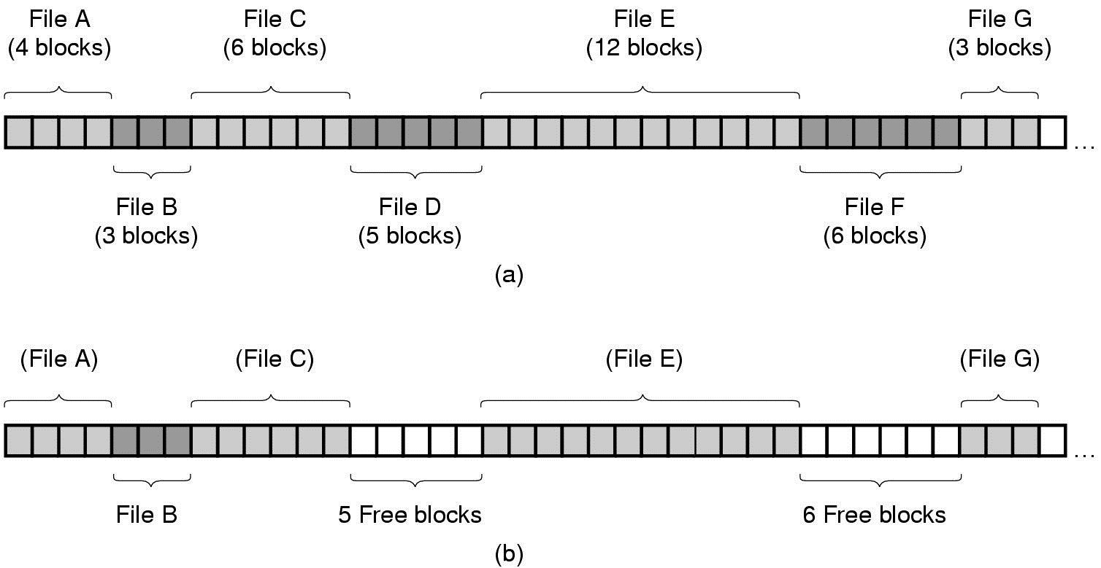
Contiguous Allocation
Contiguous allocation of disk space for 7 files
State of disk after 2 files have been removed

Slide 38
Contiguous Allocation
Store each file as a contiguous run of disk blocks. (Used on CD-ROMs)
Good:
Very simple to implement, only the disk address of the first block and the number of blocks in the file is needed.
Read performance is excellent.
Bad:
In time, disk becomes fragmented, resulting in files and holes.
To store more files, user needs to know size of files and size of holes.

Slide 39
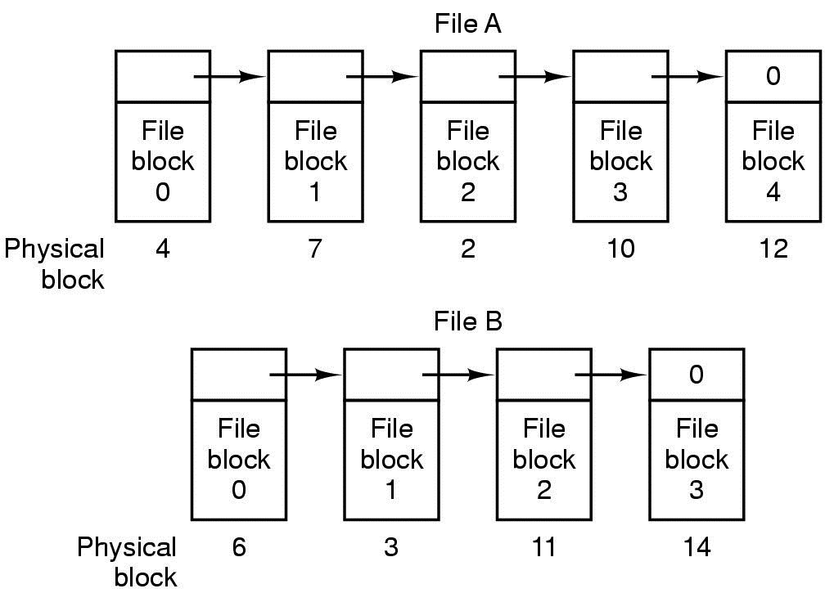
Linked List Allocation
Each file is stored as linked list of blocks First word of each block points to next block
Notes:
Part of block is used as link-list pointer.

Slide 40
Linked List Allocation
Keep each file as a linked list of disk blocks. The first word of each block is used as a pointer to the next one. The rest of the block is for data.
Good:
Every block in the disk can be used by a file.
Directory entry only need to store the disk address of the first block of the file.
Bad:
Random access is extremely slow.
Overhead of using pointers (file space)

Slide 41
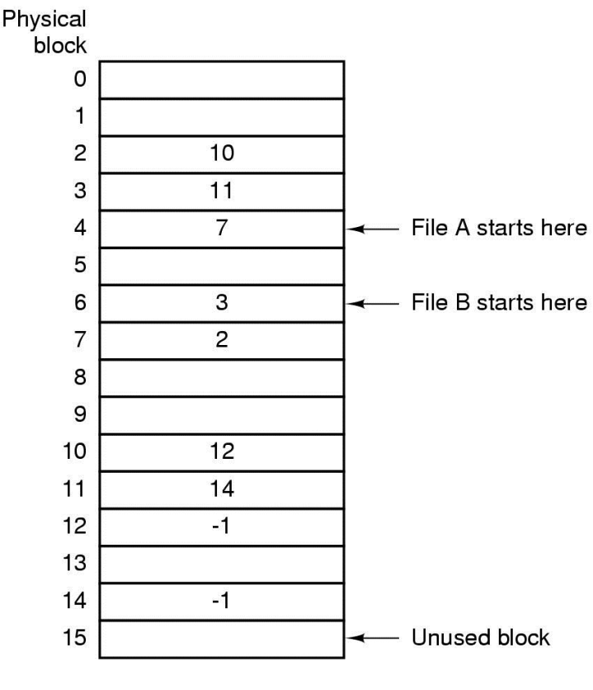
MS-DOS File System
Implement a linked list allocation using a table
Called File Allocation Table (FAT)
Take pointer away from blocks, store in this table
Notes:
The de facto standard for interchangeable filesystems is the FAT system.
FAT is a 32-bit filesystem, so it has a maximum file size of 4GB.
FAT has no support for Linux file ownership and permissions, so the default is the user who mounted the FAT. One solution is to give RWX to all (umask = 000).

Slide 42
File Allocation Table
The pointer word from each disk block is put into a table instead. This table is called a FAT (File Allocation Table).
Pros:
Entire block is available for data
Random access is faster than linked list.
Cons:
Many file seeks unless entire FAT is in memory
For 20 GB disk, 1 KB block size, FAT has 20 million entries
If 4 bytes used per entry  80 MB of main memory required for FS
Notes:
In a 20 GB disk with 1 KB block size, FAT requires 20 GB/1 KB = 1 M entries. For active FTA32 table using 4 bytes (32 bits) per entry , 20 M X 4 bytes active RAM is required.

Slide 43
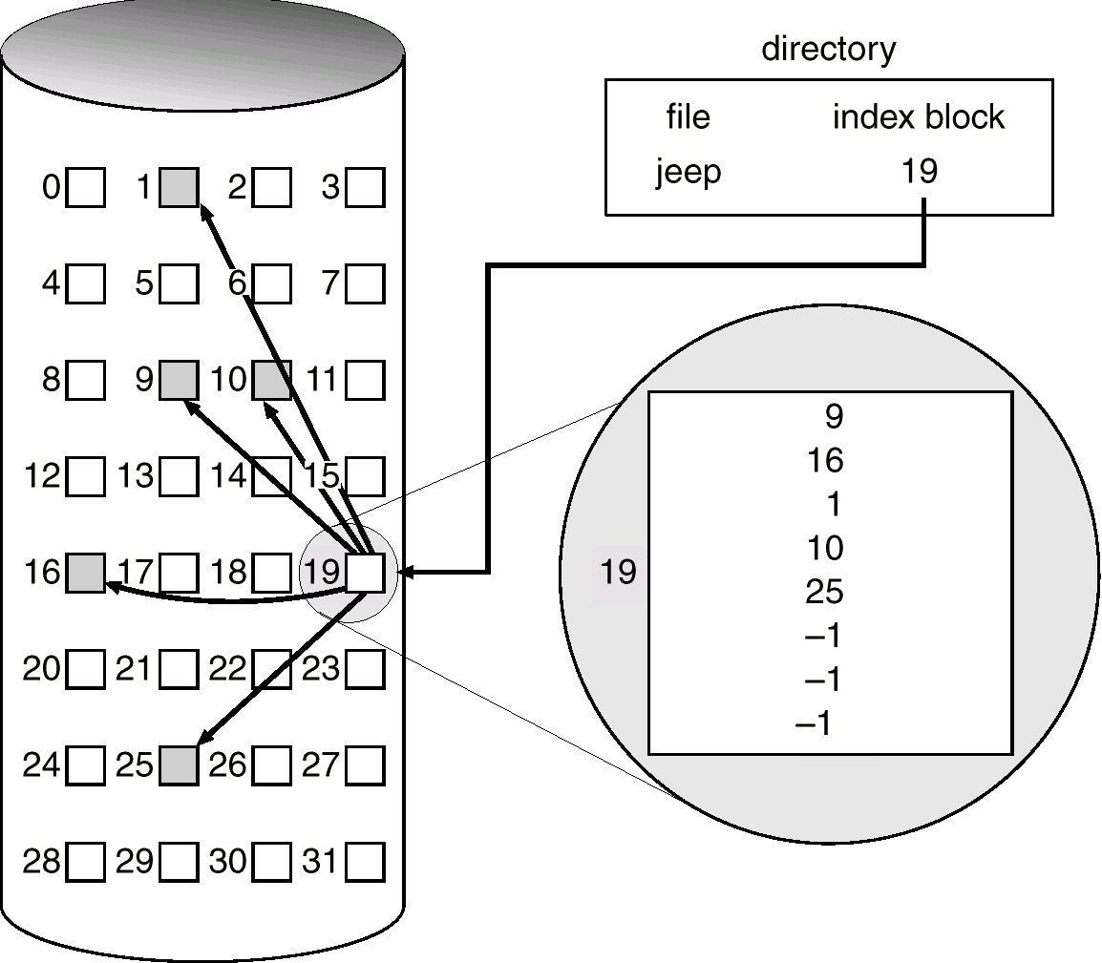
Indexed Allocation
Each file is associated with a data structure called an i-node (index node).
The i-node lists the attributes and disk addresses of the file’s blocks.
Pros:
I-node table requires less memory than FAT, depends on total number of files.
Cons:
I-node may limit file size (solution: use indirect blocks)
Notes:
Index-nodes need only be in memory when the corresponding file is opened.
$ ls -il

Slide 44
An Example of i-node
File attributes
Address of disk block 0
Address of disk block 1
Address of disk block 2
Address of disk block 3
Address of disk block 4
Address of disk block 5
Address of disk block 6
Address of disk block 7
Address of block of addresses
File attributes
Address of disk block 8
Address of disk block 9
Address of disk block 10
Address of disk block 11
Address of disk block 12
Address of disk block 13
Address of disk block 14
Address of disk block 15
Address of block of addresses
Notes:
I-nodes scheme requires an array in memory whose size is proportional to the maximum number of files that may be open at once. One problem with i-node is that each node has room for a fixed number of disk addresses, when a file grows beyond this limit, the last disk address is reserve not for a data block, but instead for the address of a block containing more disk block addresses, as shown.

Slide 45
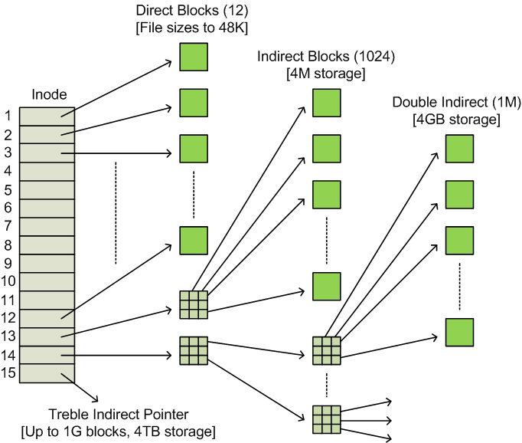
Unix File System
If data blocks are 4K …
First 48K reachable from the inode
Next 4MB available from single-indirect
Next 4GB available from double-indirect
Next 4TB available through the triple-indirect block
Any block can be found with at most 3 disk accesses

Slide 46
Original Unix System File Allocation
inode
mode
Owner & group
timestamps
size
Direct block 1
…
Direct block 12
Single indirect Double indirect
Triple Indirect
Each block is 4Kb
Pointers are 8b (64-bit)
Direct Block = 12*4K = 48K
Single Indirect = 512*4K = 2M
Double Indirect = 512*512*4K= 1G
Triple Indirect = 5123 * 4K = 512G
4K
DATA
4K
DATA
4K
4K=8*512
DATA
4K
4K
PTR
DATA
DATA
4K
4K
DATA
DATA
4K=8*512
4K=8*512
4K
DATA
PTR
PTR
DATA
4K
DATA
DATA
4K=8*512
4K=8*512
4K=8*512
4K
PTR
PTR
PTR
DATA

Slide 47
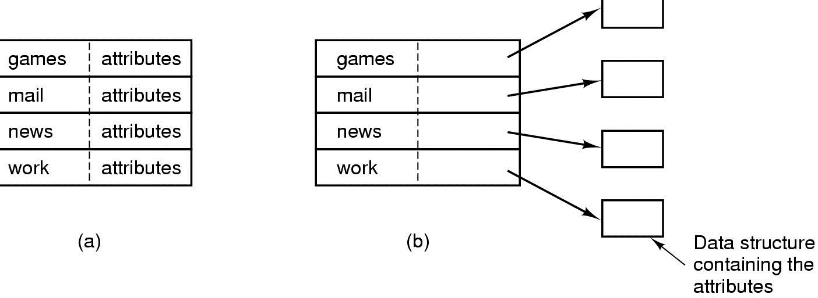
Implementing Directories
When a file is opened, OS uses path name to find dir
Directory has information about the file’s disk blocks, whole file (contiguous), first block (linked-list) or I-node
Directory also has attributes of each file
Directory: map ASCII file name to file attributes & location
2 options: entries have all attributes, or point to file I-node
Notes:
File name either fixed length or variable length. May be wasteful for keeping large fixed length in memory.

Slide 48
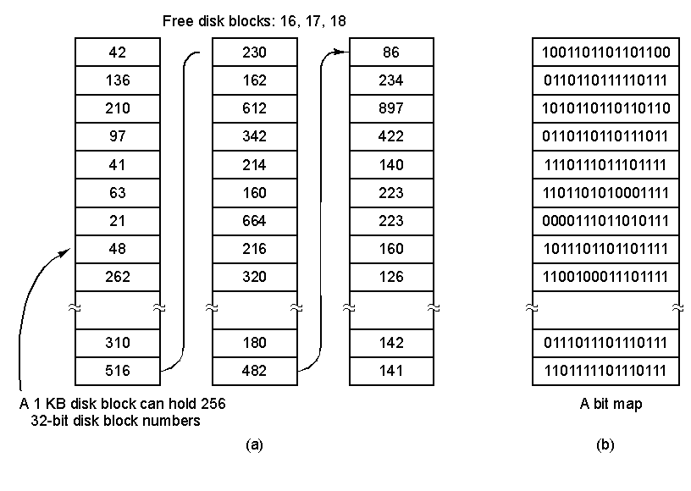
Managing Free Disk Space
Linked List Free blocks are stored on a list
Bit mapped Free blocks are indicated with a "1"

Slide 49
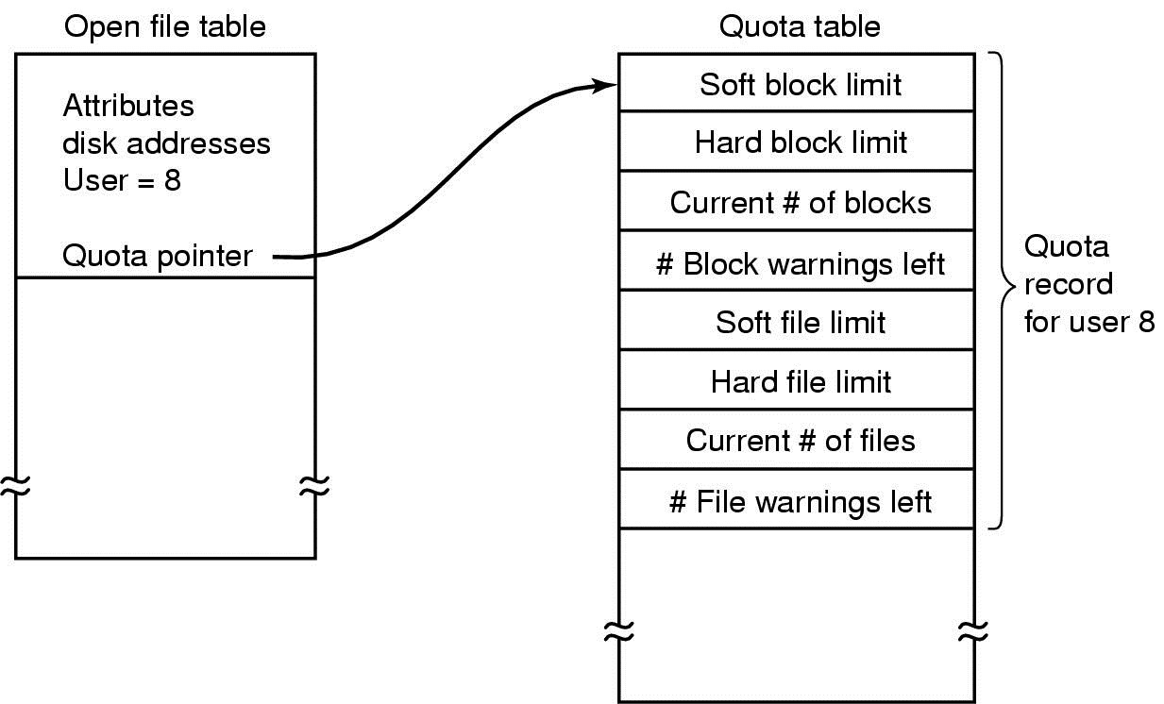
Managing Disk Quotas
Sys admin gives each user max space
Open file table has entry to Quota table
Soft limit violations result in warnings
Hard limit violations result in errors
Check limits on login

Slide 50
Efficiency and Performance
Efficiency dependent on:
disk allocation and directory algorithms
types of data kept in file’s directory entry
Performance
disk cache – separate section of main memory for frequently used blocks
free-behind and read-ahead – techniques to optimize sequential access
improve PC performance by dedicating section of memory as virtual disk, or RAM disk
Notes:
• free-behind: release block as soon as read (make space for others)
• read ahead: read blocks before you need them (so you don’t need to wait)
Link: http://pages.cs.wisc.edu/~swift/classes/cs537-sp09/lectures/13-fs-implementation.pdf

Slide 51
File System Consistency
If there is a System crash before modified files written back
Leads to inconsistency in FS
fsck (UNIX) & scandisk (Windows) check FS consistency
Algorithm:
Build 2 tables, each containing counter for all blocks (init to 0)
1st table checks how many times a block is in a file
2nd table records how often block is present in the free list
>1 not possible if using a bitmap
Read all i-nodes, and modify table 1
Read free-list and modify table 2
Consistent state if block is either in table 1 or 2, but not both

Slide 52
Log File Systems
Log structured (or journaling) file systems record each update to the file system as a transaction
All transactions are written to a log
A transaction is considered committed once it is written to the log
However, the file system may not yet be updated
The transactions in the log are asynchronously written to the file system
When the file system is modified, the transaction is removed from the log
If the file system crashes, all remaining transactions in the log must still be performed
E.g. ReiserFS, XFS, NTFS, ext3, etc

Slide 53
QUESTIONS

